Slide 1
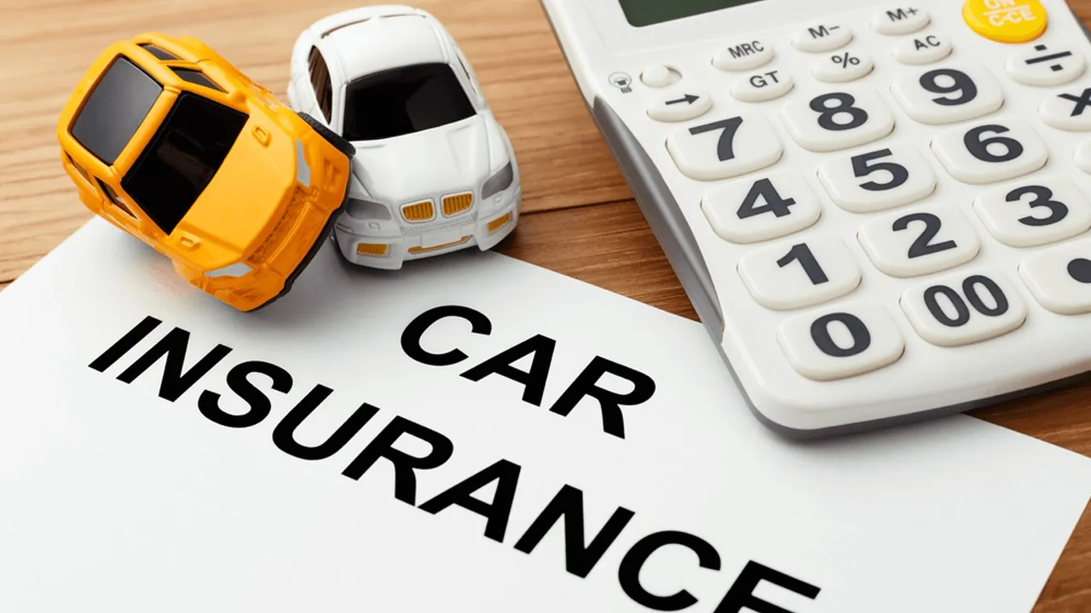
February 2023
Car Insurance Claims
Numann Malik

Slide 2
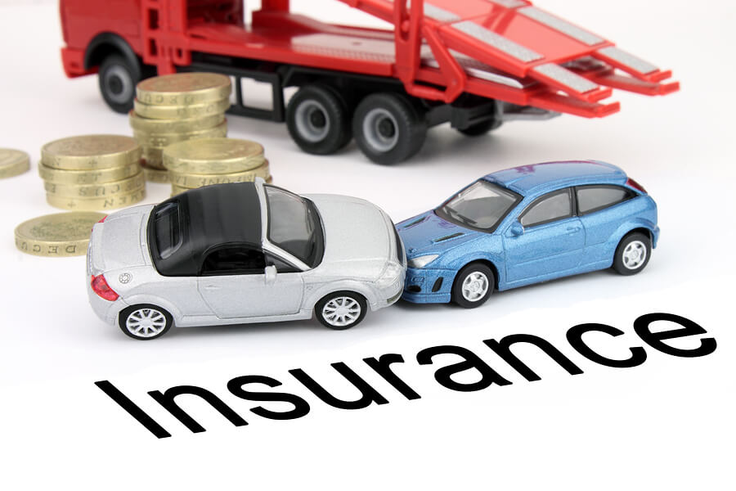
February 2023
Project Description
We analyzed behavioral data for the customers of a car insurance company.
The goal was to identify key factors that are more likely to lead a customer to filing an insurance claim (e.g. for an accident).
Our stakeholder would want to determine in particular, which customers are more accident prone and hence likely to file a claim.

Slide 3
February 2023
Car Insurance Dataset
The dataset was sourced from the Kaggle – Car Insurance Dataset from the user ‘Sagnik Roy’.
This dataset utilizes 18 features for predicting auto insurance claims. The ‘Outcome’ target feature below indicates whether a customer filed a claim (1) or not (0).
Feature Name | Description | Feature Name | Description | Feature Name | Description
Age | 16-25, 26-39, 40-64, or 65+ | Credit Score | Between 0 and 1 (scaled) | Annual Mileage | Rounded to nearest 1000 miles
Gender | Male or Female | Vehicle Ownership | 0 (no) or 1 (yes) | Vehicle Type | Sedan or Sports Car
Race | Majority or Minority | Vehicle Year | Before 2015 or After 2015 | Speeding Violations | Numerical Frequency
Driving Experience | 0-9, 10-19, 20-29, or 30+ years | Married | 0 (no) or 1 (yes) | DUIs | Numerical Frequency
Education | High School, University, or None | Children | 0 (no) or 1 (yes) | Past Accidents | Numerical Frequency
Income | Poverty, Working Class, Middle Class, or Upper Class | Postal Code | 10238, 21217, 32765, or 92101 | Outcome | 0 (no) or 1 (yes)

Slide 4

February 2023
Stakeholder
Our analysis will be utilized by a car insurance company
This is to assist with deciding which potential customers to provide coverage to, and how much to charge for their premiums.
Covering the cost of road accidents can be very expensive. Therefore, it is very important to investigate the history of current/former customers.

Slide 5
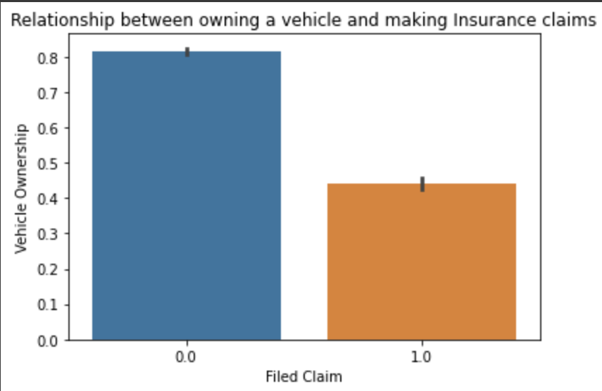
February 2023
Relevant Observation
Over 80% of customers who have never made an insurance claim owned their vehicle
More than half of customers who don’t own a vehicle made a claim
Supporting evidence that those who lease their vehicles are more likely to file claims

Slide 6
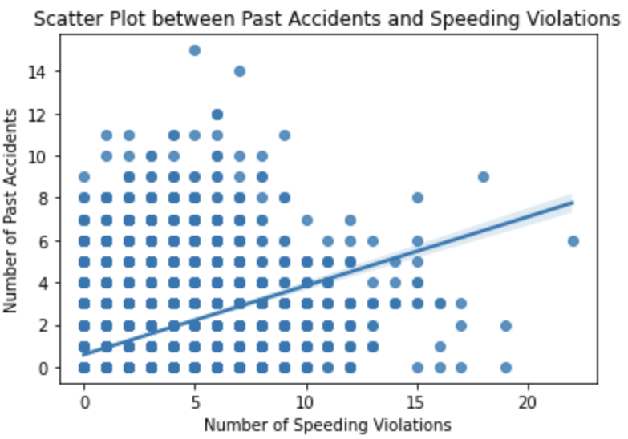
February 2023
Another Relevant Observation
There is a positive correlation between the number of past accidents and speeding violations.
We should determine both for each potential customer before deciding to grant any coverage.

Slide 7
February 2023
Model Development
Several Models were evaluated on the dataset:
Decision Tree Classification
Random Forest Classification
K-Nearest Neighbors Algorithm
Logistic Regression
Gradient Boosting
LightGBM
XGBoost
Multiple metrics were used for evaluation:
Accuracy
Precision
Recall
F1-score

Slide 8
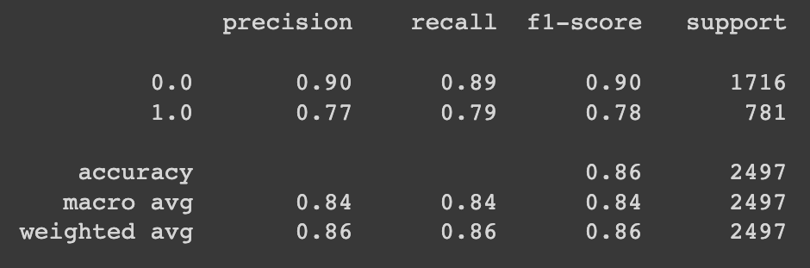
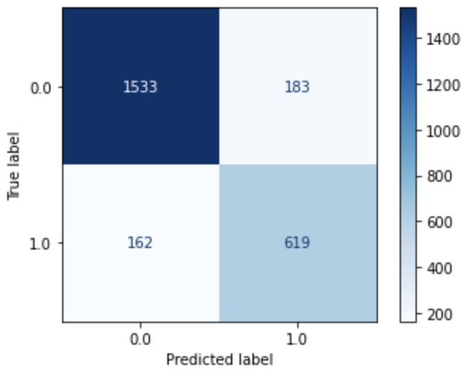
February 2023
Model Evaluation
Our stakeholder, the car insurance company, will want the model that minimizes the proportion of false negatives.
The reason is that it will cost more money to pay out for claims that were not accurately predicted.
Therefore, we mostly we care about the recall score.

Slide 9
February 2023
Recommendations
The model with the best recall score is our tuned LightGBM with 79%, i.e. 79% of customers who file claims will have been predicted to correctly, with test accuracy of 86.2%.
We also find relatively high precision (which minimizes false positives). This is interpreted as accurately predicting when customers do not file a claim. This reassures us that the insurance company can reliably pick customers who will continue to pay premiums, while not costing the insurance company more money with claims.
Finally, the insurance company should scrutinize potential customers more who lease (or who otherwise don't own) their vehicles, as well as those who have a history of speeding violations and accidents.

